Slide 1
Scan Conversation (Part 1)
Course Code: CSC 3224
Course Title: Computer Graphics
Dept. of Computer Science
Faculty of Science and Technology
Lecturer No: | 5 | Week No: | 04 | Semester:
Lecturer: | Md Masum Billah, billah.masumcu@aiub.edu, masum-billah.net

Slide 2
Lecture Outline
Midpoint Circle Algorithm (Derivation)
Midpoint Circle Algorithm (Mathematics)

Slide 3
Bresenham's Mid Point Circle Algorithm
Introduction
In computer graphics, the midpoint circle algorithm is an algorithm used to determine the points needed for rasterizing a circle. Bresenham's circle algorithmis derived from the midpoint circle algorithm

Slide 4
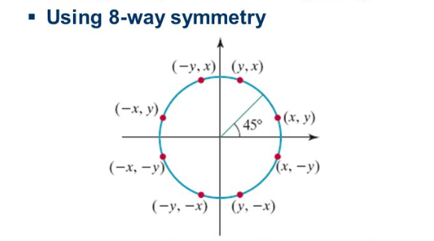
Bresenham's Mid Point Circle Algorithm
Concept

Slide 5
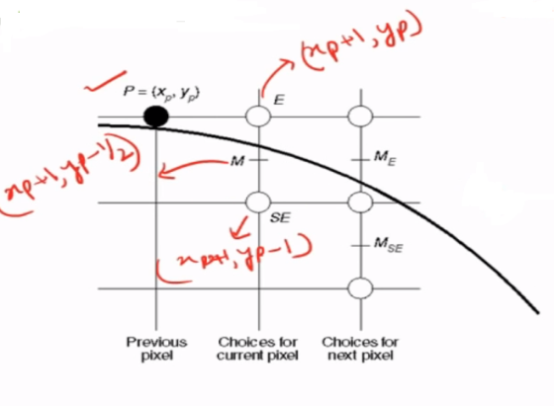
Bresenham's Mid Point Circle Algorithm
Concept

Slide 6
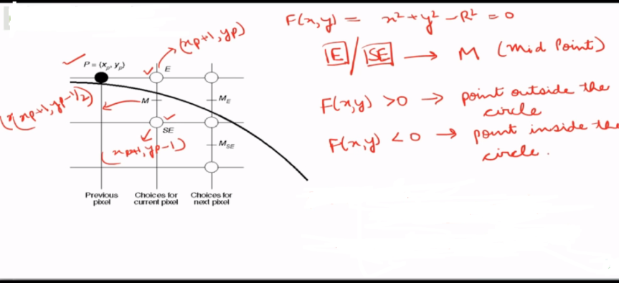
Bresenham's Mid Point Circle Algorithm
Concept

Slide 7
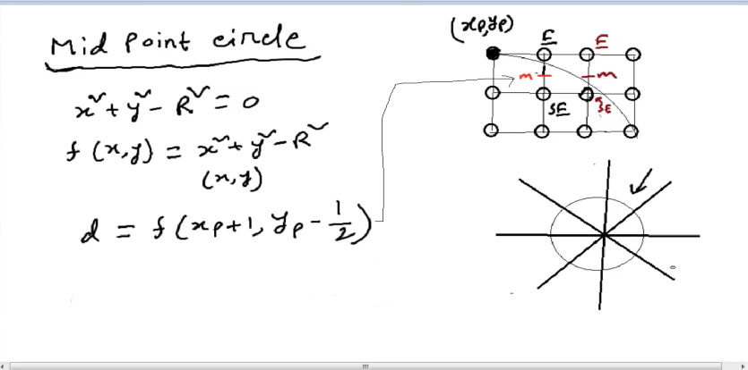
Bresenham's Mid Point Circle Algorithm
Derivation

Slide 8
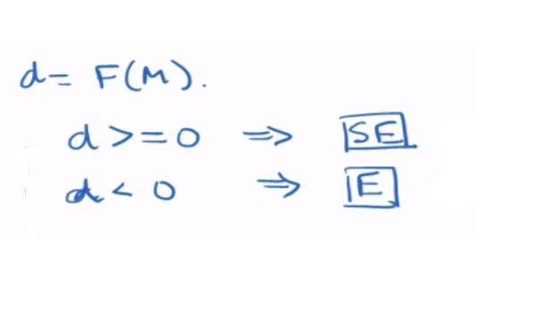
Bresenham's Mid Point Circle Algorithm
How to chose E/SE

Slide 9
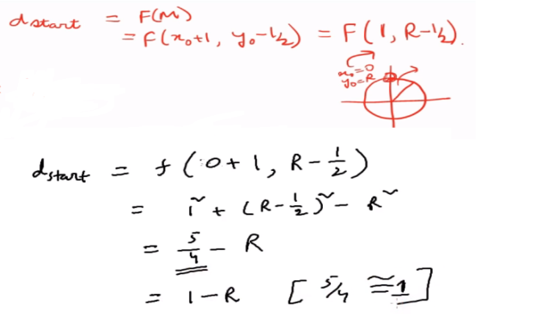
Bresenham's Mid Point Circle Algorithm
Find dstart

Slide 10
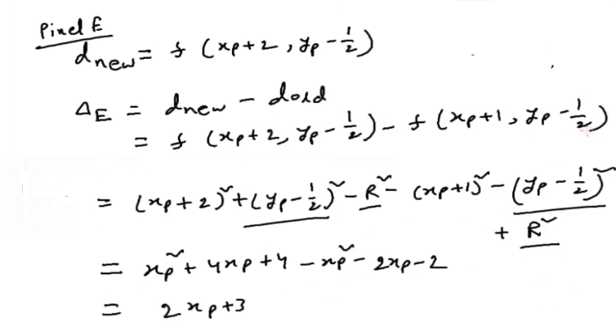
Bresenham's Mid Point Circle Algorithm
if E Selected

Slide 11
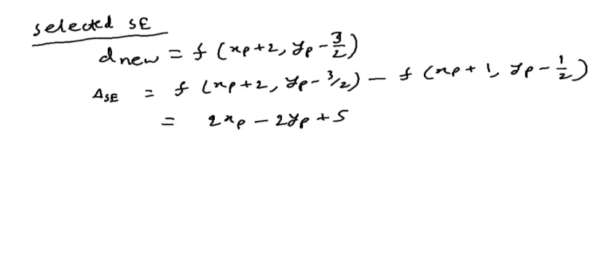
Bresenham's Mid Point Circle Algorithm
if SE Selected

Slide 12
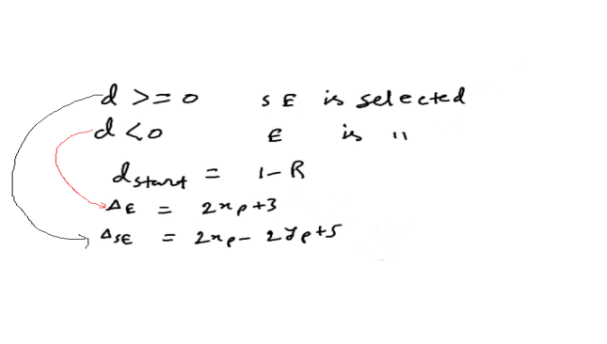
Bresenham's Mid Point Circle Algorithm
Finally

Slide 13
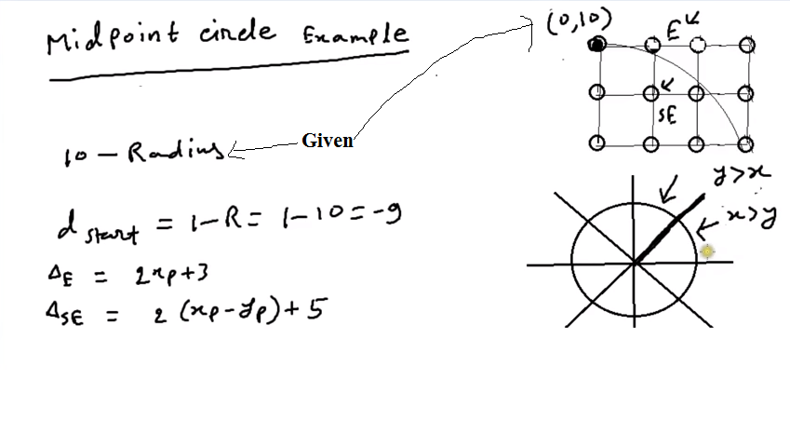
Bresenham's Mid Point Circle Algorithm
Mathematics (Question) : Center 0,0

Slide 14
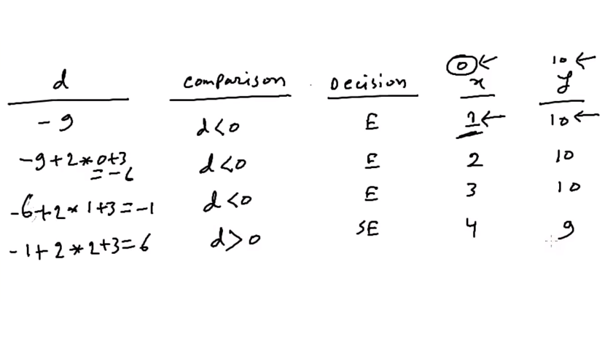
Bresenham's Mid Point Circle Algorithm
Mathematics (solution)

Slide 15
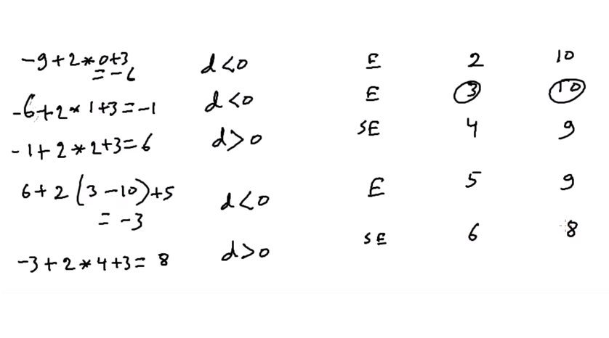
Bresenham's Mid Point Circle Algorithm
Mathematics (solution)

Slide 16
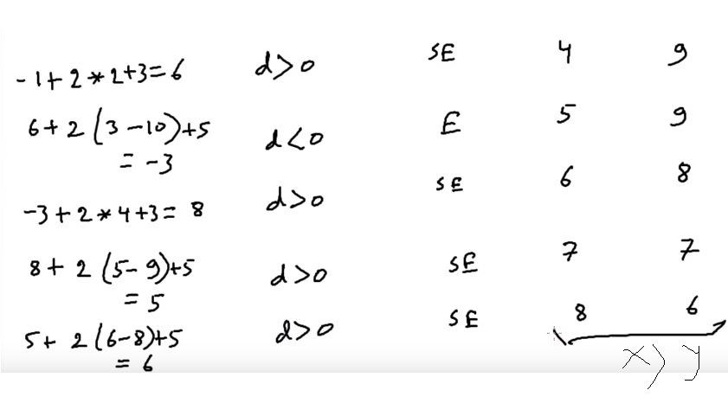
Bresenham's Mid Point Circle Algorithm
Mathematics (solution)

Slide 17
Bresenham's Mid Point Circle Algorithm
Mathematics (solution): Final Pixels
(x,y)= (1,10)
(2,10)
(3,10)
(4,9)
(5,9)
(6,8)
(7,7)

Slide 18
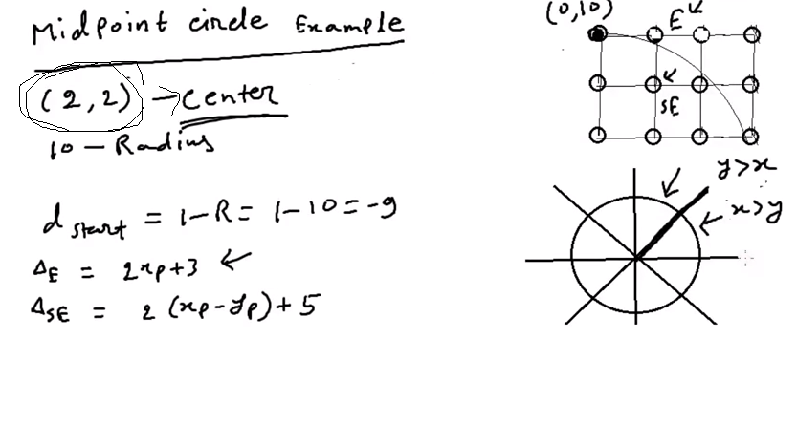
Bresenham's Mid Point Circle Algorithm
Mathematics (Question): if center is not 0,0

Slide 19
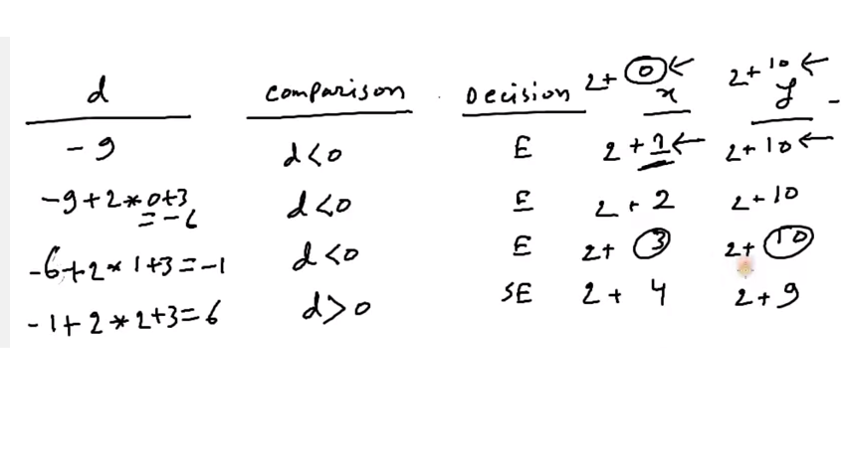
Bresenham's Mid Point Circle Algorithm
Mathematics (solution): if center is not zero

Slide 20
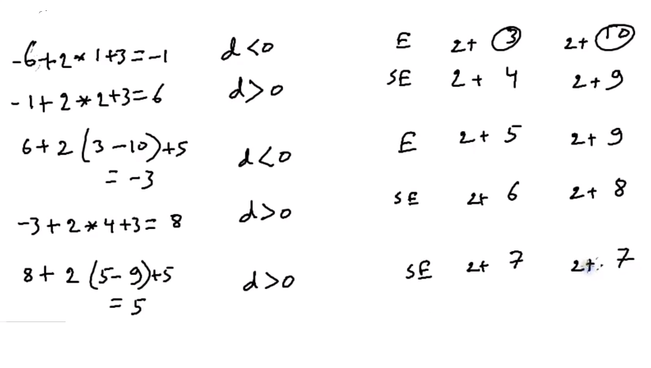
Bresenham's Mid Point Circle Algorithm
Mathematics (solution): if center is not zero

Slide 21
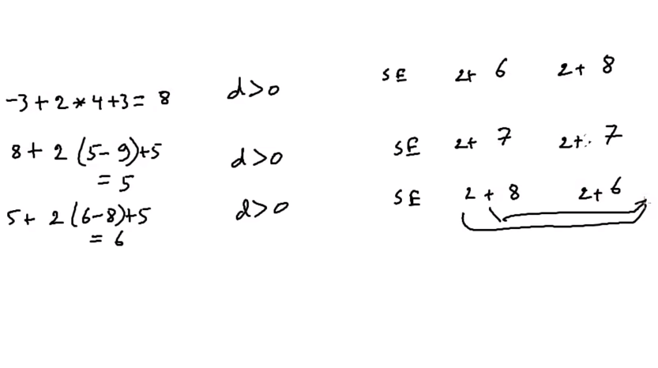
Bresenham's Mid Point Circle Algorithm
Mathematics (solution): if center is not zero

Slide 22
Bresenham's Mid Point Circle Algorithm
Mathematics (solution): if center is not zero
(x,y)= (3,12)
(4,12)
(5,12)
(6,11)
(7,11)
(8,10)
(9,9)

Slide 23
Books
Foley, van Dam, Feiner, Hughes, Computer Graphics: principles and practice, Addison Wesley, Second Edition.
Schaum's Outline of Theory & Problems of Computer Graphics.
Peter Shirley Steve Marschner , “Fundamental of computer graphics”, Third Edition.

Slide 24
References
Chapter 3: Basic Raster Graphics Algorithm for Drawing 2D Primitives.
Foley, van Dam, Feiner, Hughes, Computer Graphics: principles and practice, 2nd ed.
https://www.slideshare.net/mohammedarif89/midpoint-circle-algo?
qid=33e02b6e-628f-4b43-afcb-ea838ebf72c9&v=&b=&from_search=2
https://slideplayer.com/slide/9120741/
https://en.wikipedia.org/wiki/Midpoint_circle_algorithm
https://studyresearch.in/2018/03/11/bresenhams-circle-algorithm/

